Slide 1
LYMPHATIC & IMMUNE SYSTEM

Slide 2
2 Major types of lymphatic structures
1) Lymphatic Vessels
Reach every organ in the body
Pick up the tissue fluid (lymph) and transport it to the heart
Lymph Nodes
Pea shaped tissue along the vessels that contain compartment sinuses that house lymphocytes and macrophages
Cleans the lymph fluid

Slide 3
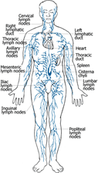

Slide 4
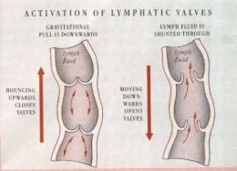

Slide 5
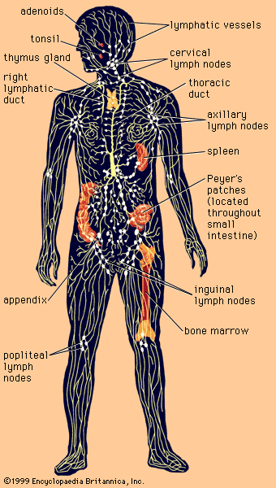

Slide 6
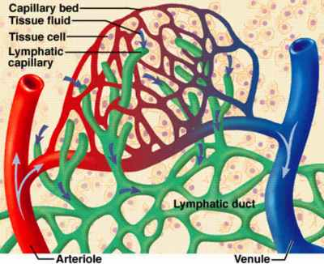
Lymphatic system is functionally related to CV system and immune system.
Drains excess fluid at capillary beds and takes the fluid back to the heart at the right lymphatic duct or the thoracic duct
Destroys bacteria through the work of the lymphocytes in the lymph nodes

Slide 7
Composition of Lymph
Clear fluid
Resembles plasma
Water
Electrolytes
Waste from metabolized cells
Some protein

Slide 8
Where Does lymph come from?
-Formed from plasma during capillary exchange
Where does lymph go?
-It is taken up into the lymphatic vessels at the capillary bed
-lymphatic vessels carry it toward the heart and eventually empties it into the blood

Slide 9
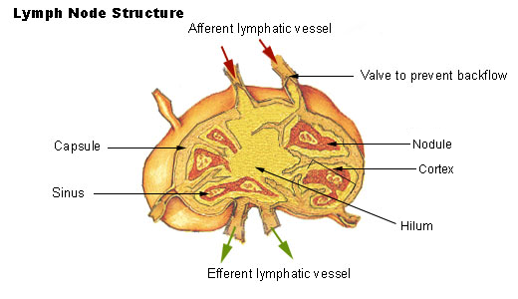
Location, histological structure & functions of lymph nodes

Slide 10
There are between 500 & 600 lymph nodes that are distributed throughout the human body. Some of these lymph nodes are found in clusters in the underarms, groin, neck, chest, and abdomen.

Slide 11
Other Lymphoid Structures
Tonsils and adenoids
Thymus gland
Spleen

Slide 12
Tonsils and Anodes
Tonsils and adenoids are similar to the lymph nodes or “glands” found in the neck, groin, and armpits.
Tonsils are two round lumps in the back of the throat.
Adenoids are high in the throat behind the nose and the roof of the mouth(soft palate) and are not visible through the mouth or nose without special instruments.
Tonsils and adenoids are the body’s first line of defense as part of the immune system. They sometimes become infected. At times, they become more of a liability than an asset & may even cause airway obstruction or repeated bacterial infections.

Slide 13
Thymus Gland
The thymus gland is positioned in the upper part of the chest cavity, directly behind the sternum. It is pinkish-gray in color and blends in with the surrounding tissue as you age. Two irregularly shaped parts make up the thymus, and though it continues to grow throughout puberty, the gland then begins to diminish in size.

Slide 14
-The Role of the thymus gland is to process lymphocytes, which are white blood cells that travel the body through the bloodstream. They stop at lymph nodes to ensure everything is working properly, and if not, it is believed that they jump into action to fix any issues. These T-lymphocytes, or T-cells, play a part in cellular immunity by blocking the invasion of harmful foreign agents, viruses, and bacteria. They also aid in preventing the abnormal cell growth that occurs with range.

Slide 15
Spleen
Left upper quadrant of the abdomen
Removes old red blood cells
Reserve of blood in case of hemorrhagic shock.
Provides lymphocytes and hence antibodies for the cellular and humoral specific immune defenses.

Slide 16
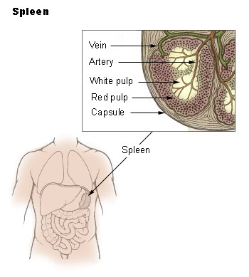

Slide 17
Protective function of surface membrane barriers
Skin- First Line of Defense
Mucous Membrane-line passageways and trap with sticky secretions and cilia sweep out impurities
Tears, perspiration, saliva, and gastric juices-contain acids and enzymes that destroy invaders
Sneezing, coughing, vomiting, diarrhea expel invaders

Slide 18
Importance of phagocytosis and natural killer cells in nonspecific body defenses
Phagocytosis
part of the second line of defense nonspecific or innate (born with)
process of phagocyte cells engulfing and destroying microorganisms and small particles
neutrophil, macrophage, and dendritic cells examples of phagocytes
Killer cells
part of the second line of defense nonspecific or innate (born with)
large granular lymphocytes
kill tumor cells, and viruses
kill by releasing perforins chemicals that rupture the membrane of the targeted cell

Slide 19
Inflammatory process
Part of second line of defense
Tissue damage stimulates the inflammatory mediators to release from mast cells found on connective tissue
histamine
prostaglandins
leukotrienes
interleukins
This attracts leukocytes to the area which is called chemotaxis making the area hot, red, swollen and painful---------this can lead to a fever but starts the body fighting off foreign invaders

Slide 20
Antimicrobial substances produced by the body that act as nonspecific defense
Interferons IFNs- glycoproteins produces by several types of cells if invaded that interfere with viruses ability to replicate
Complement- a group of about 20 inactive enzymes found in plasma that can lyses (break apart) foreign cells or mark them for phagocytic cells this is called opsonization

Slide 21
How fever helps protect the body
Alerts us of infection
Fever facilitates immune reactions
Fever may inhibit the reproduction of some microbial pathogens
Too high can be dangerous

Slide 22
What is an antigen and hapten
Part of adaptive immunity which is specific and part of the third line of defense
Antigens- a large molecule that is a foreign invader that induces the immune system to respond in a specific way
Haptens- are incomplete antigens, very small molecules that first must bind to a protein before they can induce an immune response

Slide 23
Adaptive Immunity-specific immunity
Third line of defense
Attack specific agents
Provided by 2 different types of lymphocytes B or T
Both derive from the hematopoietic stem cells in the red bone marrow

Slide 24
B cells Antibody-Mediated Immunity
B cells don’t attack pathogens directly they produce antibodies to attack
Antibodies are proteins called immunoglobulins Igs
5 class of antibodies
Some B cells are effector cells that do the work and some are memory cells that remember and recognize it if the body is invaded again by that same antigen
B cells react to antigens in the plasma

Slide 25
T cells – cell mediated immunity
T cells directly attack pathogens they don’t form antibodies
T cells are lymphocytes that have passed through the thymus gland before migrating to the lymph nodes and spleen
T cells react to cells that have already been infected.
There are different kinds of t cells
Effector T cells
Memory T cells
Killer T cells
Helper T cells

