Slide 1
1. Identify the subdivisions of the skeleton as axial or appendicular.
Axial Skeleton
-Skull, areas of the vertebral column, rib cage, sternum, & pelvis.
Appendicular Skeleton
-Arm: clavicle, scapula, humerus, ulna, radius, carpal, metacarpals, & phalanges.
-Leg: femur, tibia, tarsals, metatarsals, phalanges, fibula, & patella.
Anatomyarcade.com

Slide 2
2. State several functions of the Skeletal System.
Movement:
-Muscles attach & pull on the skeletal system in order to produce movement.
(Movement is created with the coordination of the skeletal, muscular, & nervous system. Movement is necessary for the health of the body & for the strength of the skeletal system.)
Protection:
-The skull, vertebral column, & thoracic cage protect our most vital organs. Blood vessels & nerves can also use the components of the skeletal system for protection.

Slide 3
Functions Continued……
Support:
-The skeletal system supports the attachment of the muscles and organs.
Mineral Storage:
-The matrix of skeletal tissue stores calcium, which is one of the most important minerals & electrolytes of the body.
Hematopoiesis:
-Bones house red bone marrow. Red bone marrow makes red blood cells, white blood cells, and platelets.
(hemo-blood) (poiesis-formation of)

Slide 4
3. Demonstrate knowledge, with the use of models or pictures, the major bones, their surface features, & basic features.
Head:
-A rounded, knoblike end separated from the rest of the bone by a slender region, the neck.
(head and neck of the femur)
Process:
-A large protection of a bone, such as the upper part of the ulna in the forearm that created the elbow called the olecranon process.
(Spinous process on the vertebra)

Slide 5
Surface Features
Crest:
-A distinct border or ridge, often rough, such as over the top of the hip bone. (Iliac Crest)
Spine:
-A sharp projection form the surface of a bone, such as a spine of the scapula (shoulder blade)
Foramen:
-A hole that allows a vessel of a nerve to pass through or between bones. (foramen magnum)

Slide 6
Surface Features Continued....
Sinus:
-an air space found in some skull bones.
(frontal sinus)
Fossa:
-A depression on a bone surface. (Iliac fossa)
Meatus:
-A short channel or passageway, such as the channel in the temporal bone of the skull that leads to the inner ear. (External auditory meatus)

Slide 7
http://www.daviddarling.info/encyclopedia/B/bone.html

Slide 8
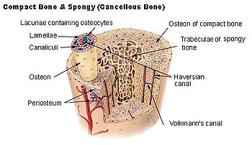

Slide 9
4. Describe the developmental aspects of the skeleton from formation in the fetus throughout the lifetime of the bones.
-As the fetus matures it changes to bone. This is called ossification.
Ossification of a flat bone occurs as osteoblasts secrete calcium and minerals into spaces between thin connective tissue.
Ossification of a long bone occurs as bone tissue replaces cartilage.

Slide 10
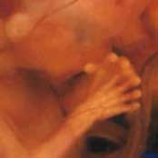
At 3 months the fetus skeleton is cartilage

Slide 11
5. Distinguish between and give functions of the major classes of joints.
Immovable- Fibrous (Synarthroses)
Ex. Sutures in skull
Slightly moveable-Cartilaginous(Amphiarthroses) Ex. Pubic symphysis and vertebral bodies

Slide 12
Classes of joints, continued.....
Freely Movable-Synovial (Diarthroses)
-Uniaxial
Hinge-elbow & knee
Pivot-head
-Biaxial
Saddle-thumb
Condyloid-temporal and mandible bone
-Multiaxial
Ball & socket-shoulder and hip
Gliding-carpals

Slide 13
6. Identify & understand functions of tendons & ligaments.
Tendons- attaches muscle to bone
Ligaments- attaches bone to bone at joints.

Slide 14
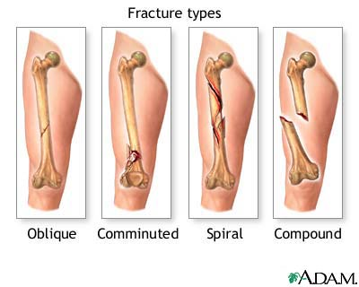
7. Understand the causes & current medical treatments of skeletal disorders and abnormalities.
FRACTURES

Slide 15
Different types of bone fractures.
Oblique- a fracture which goes at an angle to the axis.
Comminuted-a fracture of many relatively small fragments.
Spiral-a fracture which runs around the axis of the bone.
Compound-a fracture which breaks the skin
(also known as- open fracture)

Slide 16
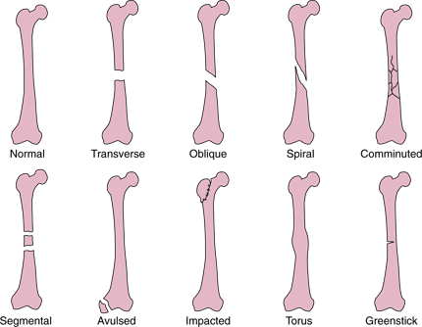
Common Types Of Fractures

Slide 17
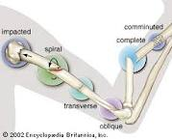

Slide 18
Skeletal Disorders
Osteoarthritis- degenerative joint disease (DJD) results from aging & wear and tear.
Rheumatoid arthritis- autoimmune disorder in which the body produces antibodies that attack normal tissue
Gout- over production of uric acid. Forms crystals in joints

