Slide 1
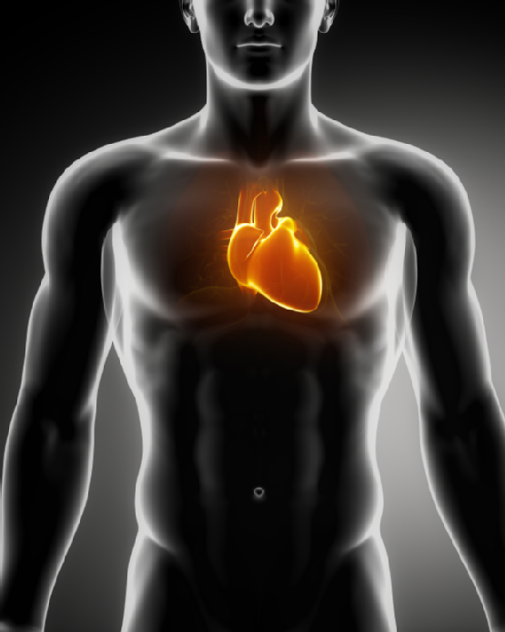
1. Describe the location of the heart in body and identify its major anatomical areas on a model of diagram.
Size of a fist
Lies toward the left side
Between the lungs
Above diaphagm
Apex pointed toward the
left located 5th and 6th rib
Surrounded and
supported by the
pericardium

Slide 2
https://www.youtube.com/watch?v=h8B3JBW_mX8 https://www.youtube.com/watch?v=xS3jX1FYG-M http://www.wilkes.med.ucla.edu/intro.html

Slide 3
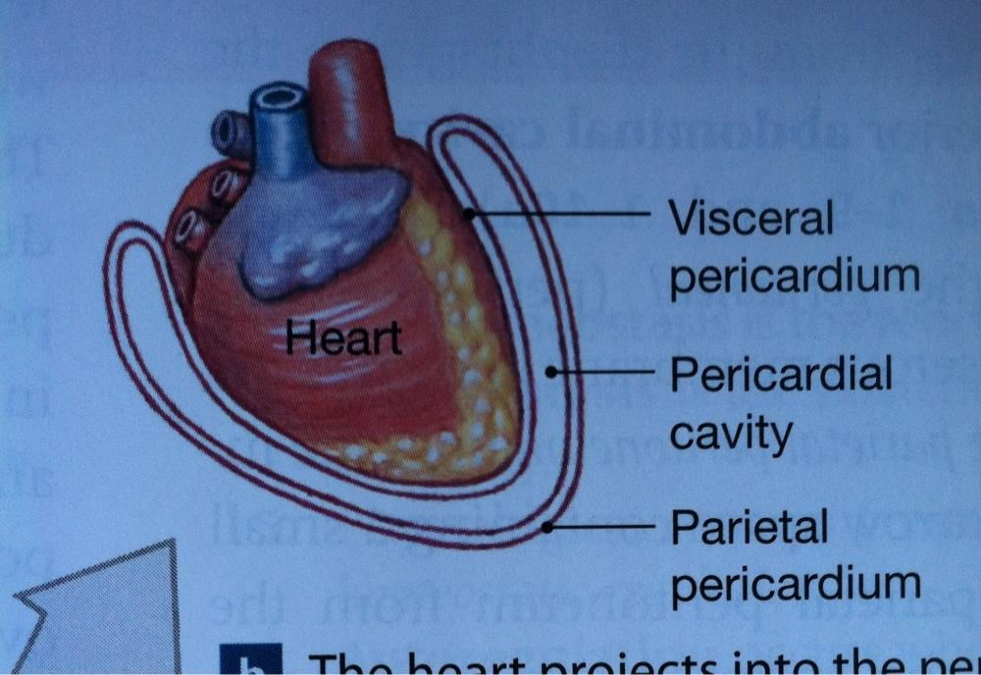
2. Name the coverings of the heart.

Slide 4
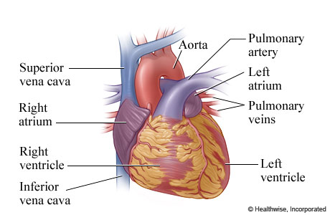
3. Describe the structure and functions of the four heart chambers. Name each chamber and provide the name and general route of its associated great vessel.

Slide 5
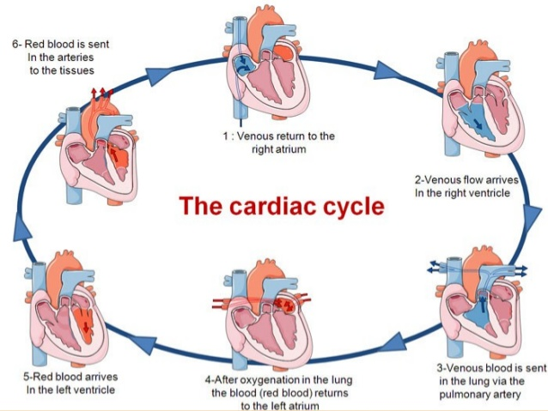

Slide 7
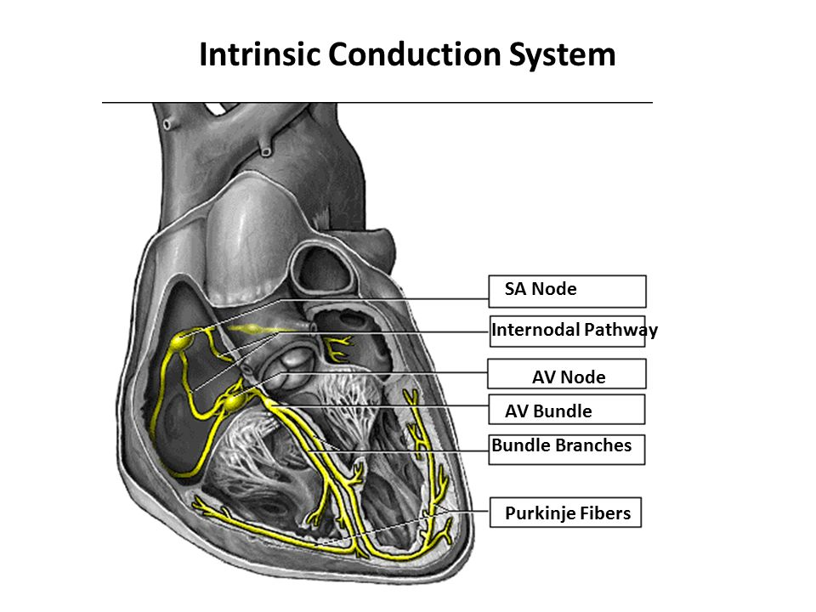
4. Id the elements of the intrinsic conduction system describe pathway of impulse.
https://www.youtube.com/watch?v=T4x7-2HKtJ0
https://www.youtube.com/watch?v=RYZ4daFwMa8

Slide 8
5. Explain what info can be gained from electrocardiogram
Heart rate
Heart rhythm
Conduction abnormalities
Prior heart attack (MI myocardial infarct)
Whether there may be coronary artery disease
Whether the heart muscle has become abnormally thickened

Slide 10
Depolarization-electrical activity that triggers a contraction of the heart muscle
Also known as systole
Systolic blood pressure force with witch blood pushes against artery walls when ventricle's contract
Repolarization-resting state
Also known as diastole relaxation of heart during witch chambers fill with blood
Diastolic blood pressure in arteries when heart relaxes

Slide 11
6. Compare and contrast the structure an functions of arteries, veins, capillaries
Arteries- tough, elastic, carry oxygenated blood away from heart, largest size of thumb, smallest called arterioles size of a hair
Veins- carry deoxygenated blood to the heart, smallest are called venules, valves are present
Capillaries- point arteries and veins connect, thin fragile one epithelial cell thick allowing exchange of O2 and CO2

Slide 12
7. Define vasoconstriction and vasodilation
Constriction- vessels get smaller in diameter, increasing blood pressure
Dilation- vessels get larger in diameter, decreasing blood pressure

Slide 13
8. Identify the body's major arteries and veins, and name body region supplied my each

Slide 14
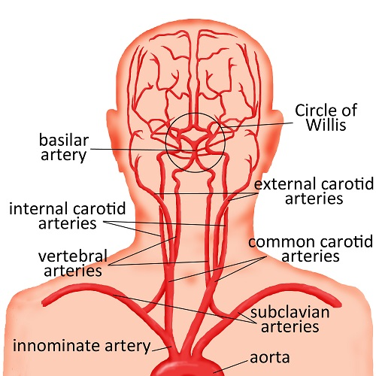
9. Discuss the unique features of special circulations of the body
Arterial to the brain
http://www.chw.org/display/PPF/DocID/48513/Nav/1/router.asp

Slide 15
Hepatic portal
http://www.healthline.com/human-body-maps/portal-vein
https://www.youtube.com/watch?v=czTB8RpY0ag

Slide 16
Pulmonary
http://www.youtube.com/watch?v=0jznS5psypI

Slide 17
Fetal Circulation
http://www.youtube.com/watch?v=-IRkisEtzsk

Slide 18
https://www.youtube.com/watch?v=AIcAF34MPpU
Excellent overview video

Slide 19
10. List and explain the factors that influence blood pressure and describe how blood pressure is regulated
Normal BP is 120/80
Systolic/diastolic
Too high called hypertension
Too low hypotension

Slide 20
BP is controlled by rapid and slow mechanisms
Rapid:
baroreceptors in aortic arch and carotid sinus carry sensory impulse to cranial nerve IX glossopharyngeal and X vagus
The medulla oblongata interprets the data and sends a message for a ANS to vasodilate or vasoconstrictor vessels and increase or decrease the HR
In turn increasing or decreasing cardiac output
In turn increasing or decreasing BP
Also epinephrine and norepinephrine hormones cause vasoconstriction in fight or flight

Slide 21
Slow BP control
Kidneys control the renin-angiotensin-aldosterone levels that increase blood volume and cause vasoconstriction

Slide 22
11. Describe the structure and function of capillary bed
Capillaries connect arterioles and venules
Capillary walls are one cell thick allowing exchange of nutrients between blood and body cells or blood and O2 or CO2 in the lung tissue

Slide 23
12. Describe the fetal circulation
Umbilical vein
Ductus Venosis- umbilical vein to inferior vena cava
Foramen ovale- opening btw R and L atriums
Ductus Arteriosis- vessel btw pulmonary arteries and Aortic arch
Umbilical artery

Slide 24
1. Describe the composition and physical characteristics of whole blood and explain why it is classified as a connective tissue
It connects everything together in circulatory system bringing O2, nutrients, and hormones to cells and tissue
Erythrocytes-RBC-transport 02
Leukocytes-WBC-protect against infection
Thrombocytes-Platelets- clot blood

Slide 25
2. List the functions of the blood
Transportation-02, C02, nutrients, waste, hormones
Regulation- pH, fluid balance and osmotic pressure, heat
Protection- from pathogens and blood loss in injury

Slide 26
3. Discuss the composition and function of plasma
90% water
protein-albumin mostly
Clotting factors
Antibodies
Enzymes
Nutrients: Glucose-amino acids-lipids-electrolytes (chloride, carbonate, phosphate, sodium, potassium, calcium, magnesium)-vitamins
Hormones
Drugs
Waist products

Slide 27
4. Describe the blood clotting process
Stage I-Injury to vessel wall activated clotting factor producing prothrombin activator (PTA)
Stage II-In the presence of calcium, platelet chemicals, and PTA prothrombin is activated to form thrombin
Stage III-Trombin activate fibrinogen forming fibrin net that traps blood cells and forms the clot. Other Factors stabilize and strengthen the clot

Slide 28
5. Describe the ABO Rh blood groups and explain the basis of transfusion reaction
Type A has A antigen on the RBC and anti B antibodies in the plasma
Type B has B antigen on the RBC and anti A antibodies in the plasma
Type AB has A and B antigens on the RBC and no antibodies in plasma (universal recipiant)
Type O has no antigens on the RBC and has A and B antibodies in the plasma (universal donor)

Slide 29
Rh factor
Rh positive person has Rh antigen on the RBC
Rh negative does not have Rh antigen and may develop anti-Rh antibodies if exposed to Rh positive blood
Rh negative mother caring Rh positive baby may cause antigen-antibody reaction leading to erythroblastosis fetalis
Rh positive person can have positive and negative transfusion
Rh negative only negative blood

Slide 30
6. Explain the importance of testing as a diagnostic tool
Detecting anemic forms of disease
Infection
Clotting disorders and bleeding times
Electrolyte and fluid imbalance
Toxicity
Pregnancy
Drug levels
Cholesterol and levels and cardiac enzymes
Liver functioning
Blood sugar
Arthritis
Lupus
STDs

Slide 31
7. Name some blood disorders that become more common with age.
Fasting blood sugar elevation
Increased serum lipids
Taking longer to produce blood cells
Increasing bleeding problems
Slowed WBC activity increasing infections
Slowing the healing process

