Slide 1
Integumentary System
1. Have an understanding of the functions of the skin and be able to relate them to its structure.
Protection
Against Infection
Against Dehydration
Body Temp Regulation
Collection of Sensory Information
Drug Absorbtion
Excretion of waist-water salt urea
Vitamin D Synthesis

Slide 2
2. Recognize & Identify the major skin structures
Skin Layers
Epidermis(stratified squamous epithelial cells about 0.1mm in thin skin and 1mm or more in thick skin)
Top level called stratum corneum (30 layers of dead hardened flattened (keratonized) cells, these cells water proof the body)
Bottom level called stratum germinativum. Also called Basal cells (close to the blood supply, continuously dividing and pushing up melanocytes are located in this layer)

Slide 3
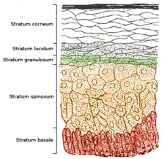
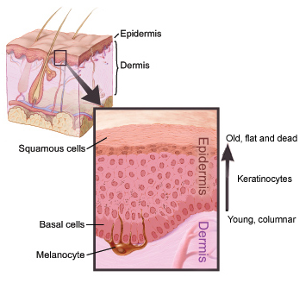
Epidermis
Stratum Corneum
Stratum Lucidum
Stratum granulosum
Stratum spinosum
Stratum basale

Slide 4
Dermis
True Skin
Dense fibrous connective tissue contains collagenous elastic fibers
Contains
Hair
Nails
Glands
Blood Vessels
Nervous Tissue (sensory receptors)
Some muscle tissue

Slide 5
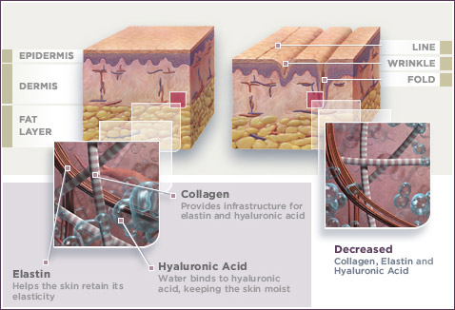
Dermis

Slide 6
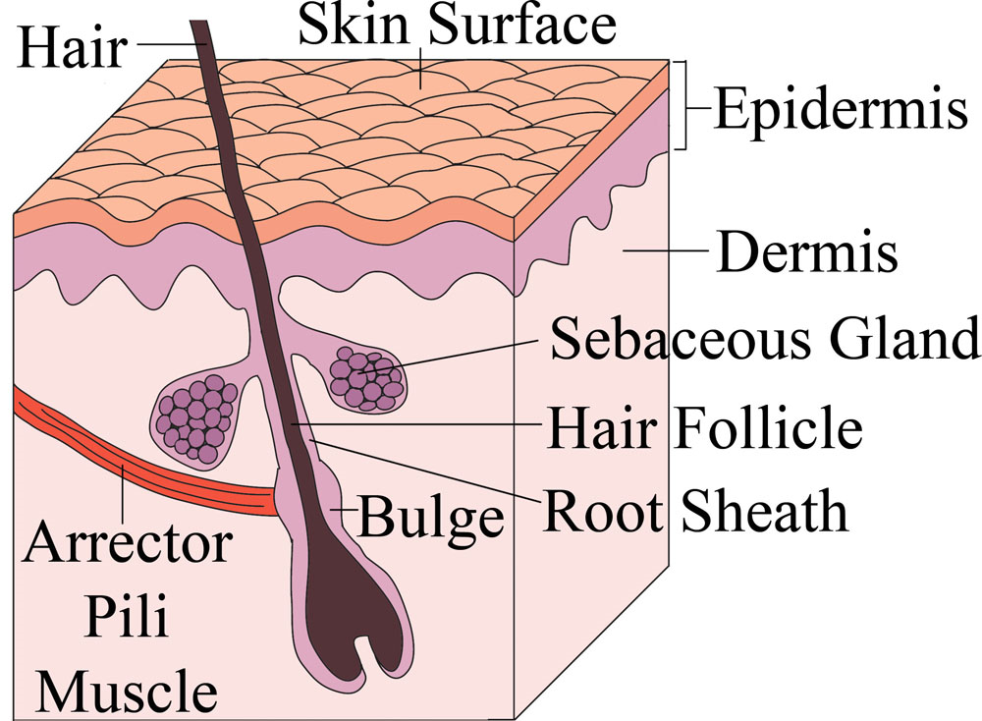
Arrector Pili Muscle
Smooth muscle cells attached to the hair follicle that makes it stand up
Cause goose bumps or goose flesh
Goose bumps are caused by a reflex called piloerection. They are an automatic response, like sweating or increased heart rate. We can’t easily control them.
Like other emotion-linked reflexes—blushing, turning pale, butterflies in the stomach – goose bumps are triggered by the limbic system of the brain.

Slide 7
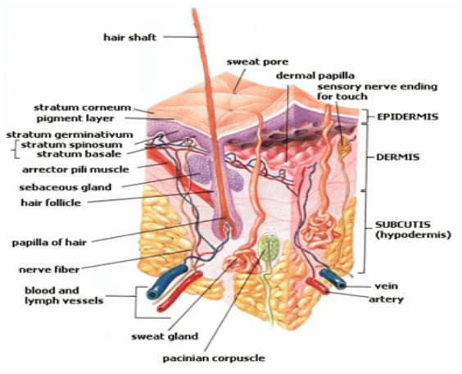

Slide 8
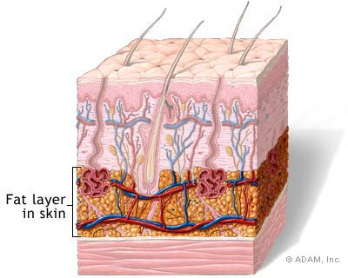
Subcutaneous Layer
Composed of Adipose tissue and Loose connective tissue
Insulates the body
Anchors the skin

Slide 9
Identify & know the purpose of the accessory structures of the skin
Glands
Sudoriforous (sweat glands reg. temp)
Ceruminous glands (ear wax or cerumen)
Ciliary glands (edge of eyes)
Mammary glands (milk)
Sebaceous glands (produces sebum lubricates skin, can lead to black heads if mixed with keratin & pimples if infected or blocked sebaceous cysts

Slide 10
Hair
Made of Keratin
Surrounded
Nails
Hard Keratin
Indicate general health through color, thickness, shape & texture
Grooves and splits may indicate heart disease, malnutrition, or anemia

Slide 11
4. Describe the normal and pathological colors that the skin can have and explain their causes
Skin color is due to:
Blood Flow
Diet
Genetics
Physiology
Disease

Slide 12
5. Identify and differentiate between the three types of skin cancer
Basal Cell Carcinoma
Squamous Cell Carcinoma
Malignant Melanoma

Slide 13
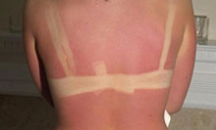
6. Describe the 3 classes of burns and the priorities in burn treatment
Burns are classified based on their depth
A First Degree Burn is superficial and causes local inflammation of the skin
Sunburns often are categorized as first degree burns
The inflammation is characterized by pain, redness and a mild amount of swelling
The skin may be very tender to touch

Slide 14
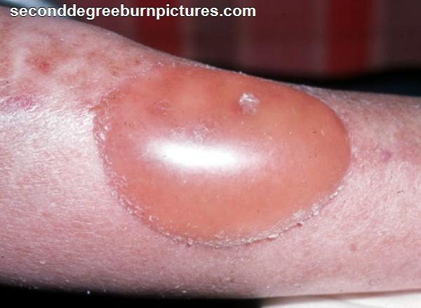
Second Degree Burns
Second degree burns are deeper and in addition to the pain, redness and inflammation, there is also blistering of the skin

Slide 15
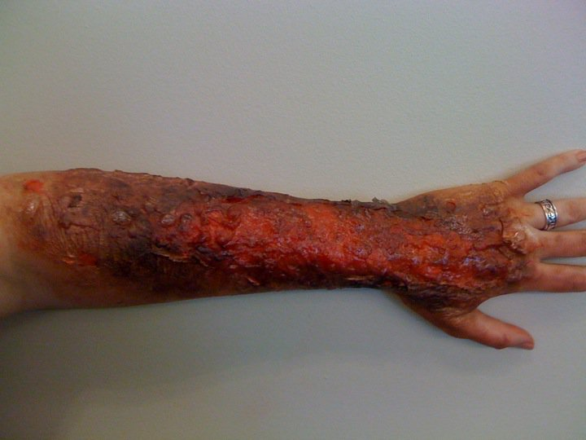
Third Degree Burns
Third degree burns are deeper still, involving all layers of the skin, in effect killing that area of skin
Because the nerves and blood vessels are damaged, third degree burns appear white, leathery, and tend to be relatively painless

Slide 16
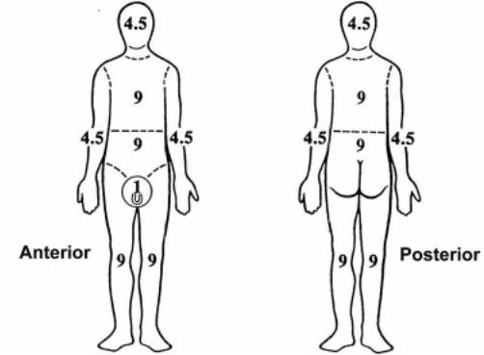
Burns
In addition to the depth of the burn, the total area of the burn is significant, burns are measured as a percentage of total body area affected. The “Rule of Nines”.
As an example, if both legs (18% X 2 = 36%), the groin (1%) and the front chest and abdomen were burned, this would involve 55% of the body

Slide 17
7. Understand the role of the integumentary system in maintaining homeostasis
Controls Temperature
Controls Fluid and Electrolyte Balance

Slide 18
Bug Bites and Skin
http://www.medicinenet.com/bad_bugs_pictures_slideshow/article.htm

